Slide 1


MOVIE BOOKING APPLICATION
Submitted by : ALEN ANTONY
Submission type : Individual
Name : Movie Booking Application
Batch : B1
LMS Id :
Program : HDFC API Development
Date: 20-04-2023

Slide 2

Table of contents
Introduction
Project Overview
Architecture Design
UML Diagrams
Back-end Development
Testing
Deployment
Future Work
References
Screenshots
Conclusion

Slide 3
Introduction
Movie booking application makes booking your favourite
movies simple and hassle-free.
You can enjoy an incredible cinematic experience
You can Book tickets, cancel Bookings and search movies/theatres/shows and many more

Slide 4
Project Overview
Movie booking application makes it easy for users to book movie tickets online, saving time and effort. With convenient payment options, it's the perfect solution for planning movie outings with friends and family.
Key Features:
Search for movies by title, genre.
Search for theatres by location, theatre name.
Select show and seats, make payments, and receive confirmation.
Cancel the booking at anytime before the show begins.
Add or view reviews for a movie.

Slide 5
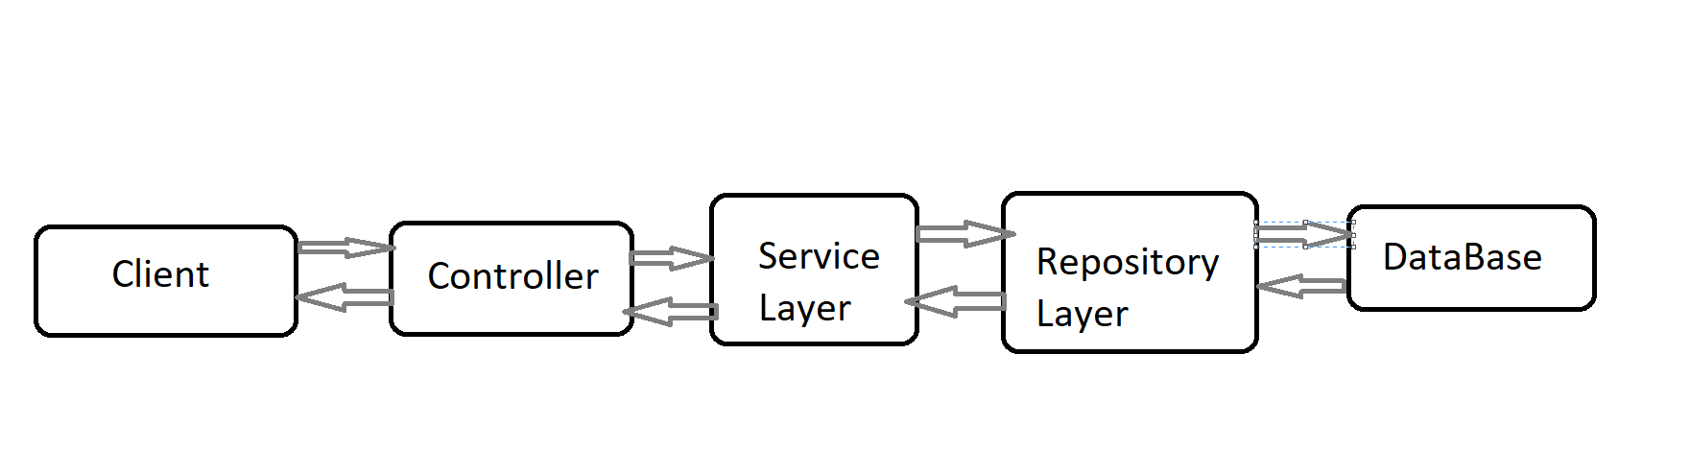
Architecture Design

Slide 6
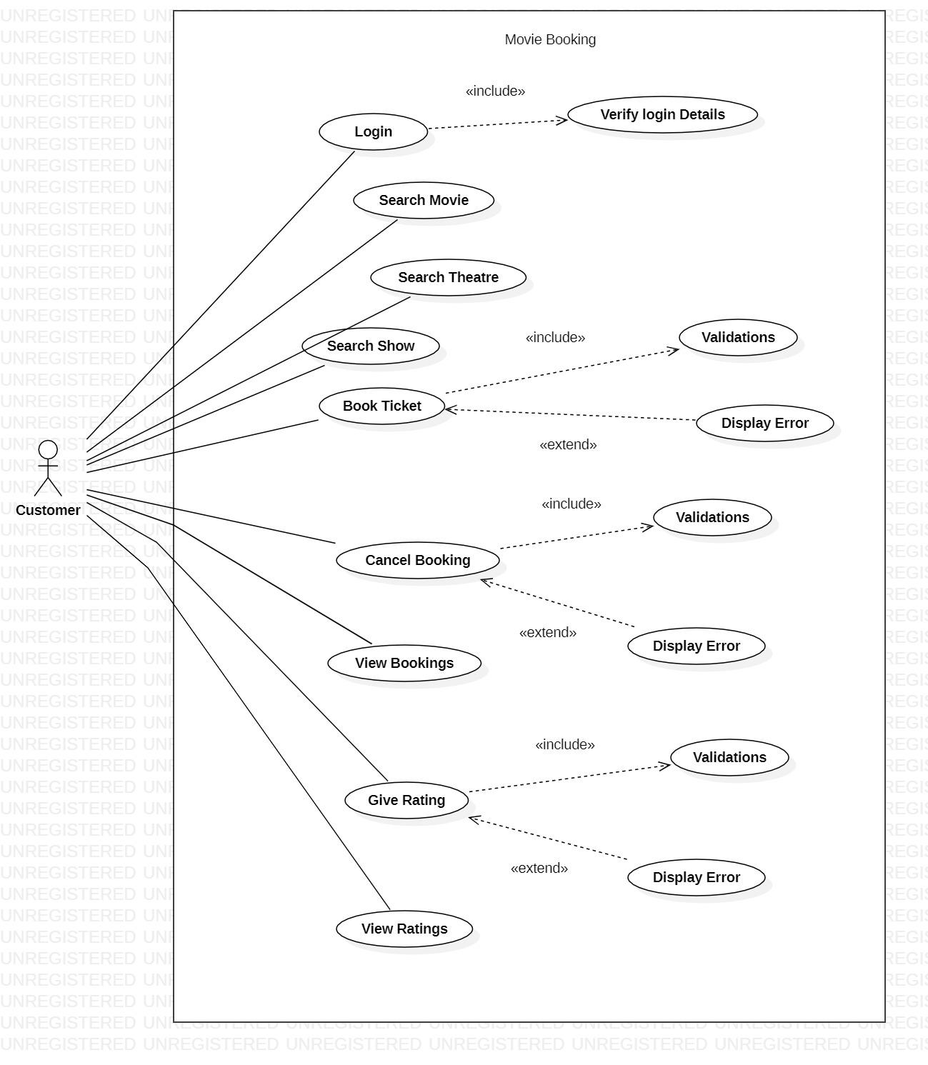
UML Diagram - Use Case Diagram

Slide 7
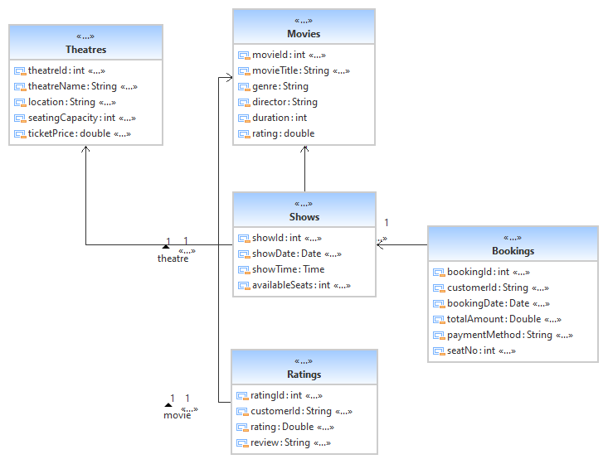
UML Diagram - Class Diagram

Slide 8
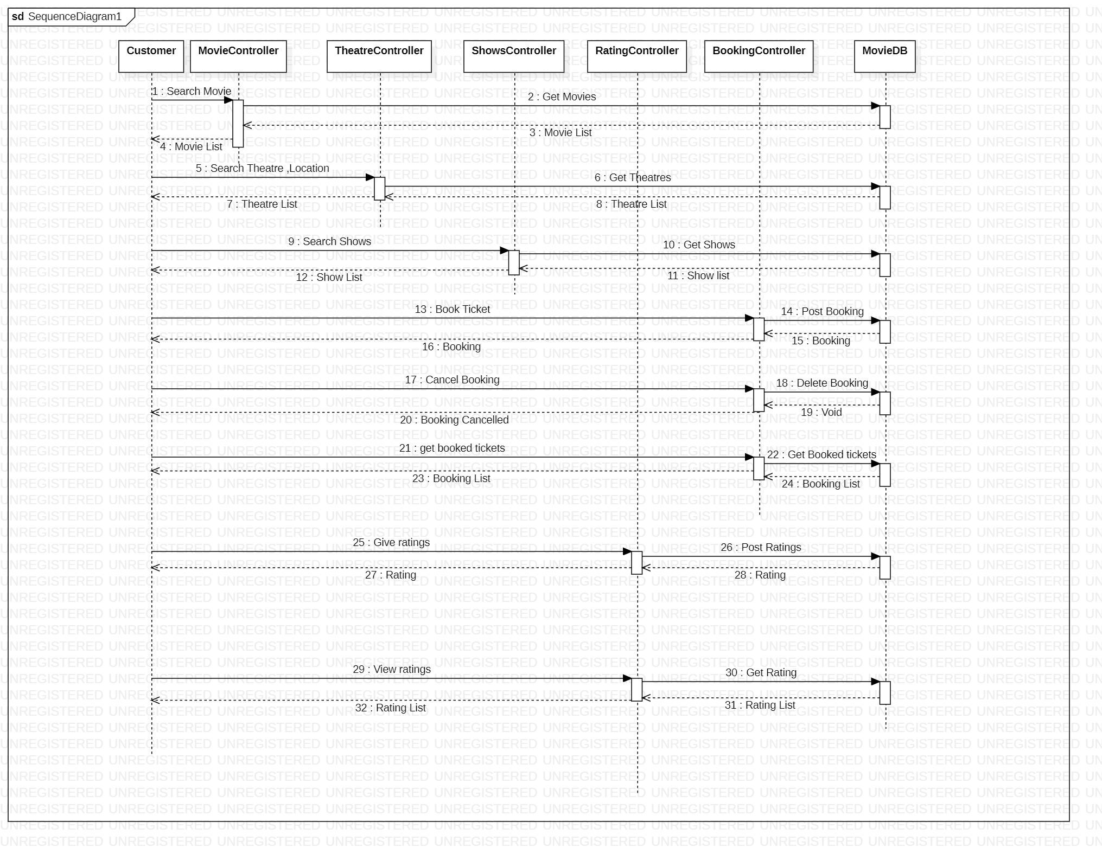
UML Diagram - Sequence Diagram

Slide 9
Back-end Development
Modules :
Movie : Search Movies by its name / Genre.
Theatre : Search Theatre by its name / location.
Shows : Search Shows by movie anime.
Booking : Book Ticket, Cancel Booking, Booking History.
Rating : Add Rating and Reviews, View Ratings for a movie.

Slide 10
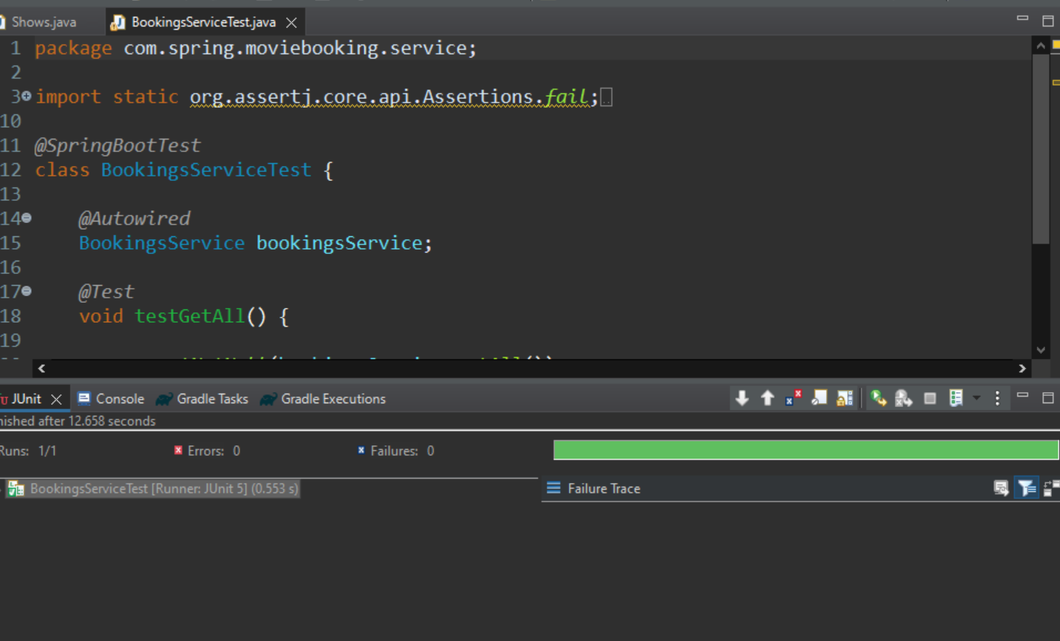
Testing
Implemented the unit Testing using Junit for service and controller package.

Slide 11
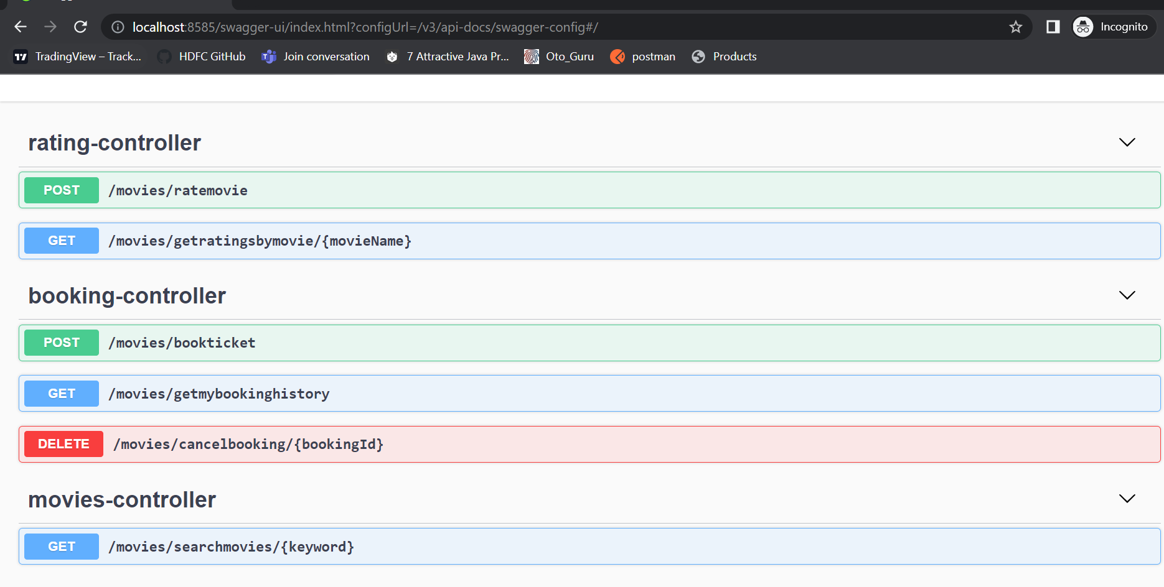
Deployment
Application is deployed using Jenkins.

Slide 12
Future Work
Multiple Seat Selection in Bookings.
Booking History for cancelled Tickets.

Slide 13
References
Stack OverFlow
ChatGPT
YouTube

Slide 14
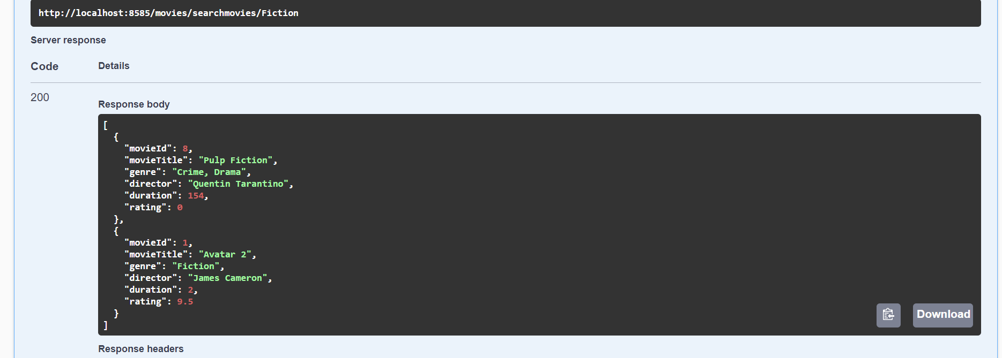
Screen Shots
Search Movies by Title or Genre

Slide 15
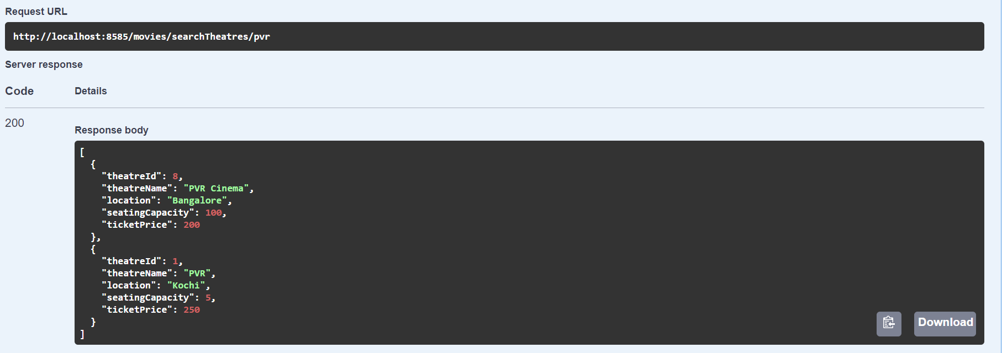
Screen Shots
Search Theatres by Location or Name

Slide 16
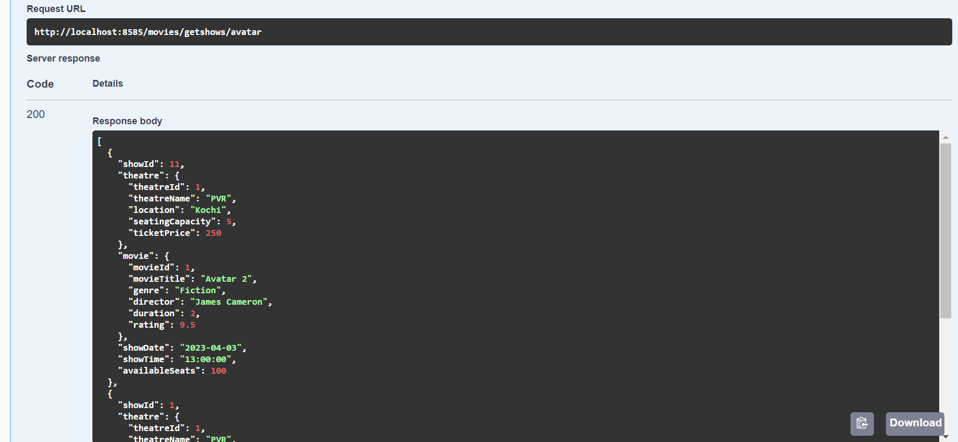
Screen Shots
Search Shows by Movie Title

Slide 17
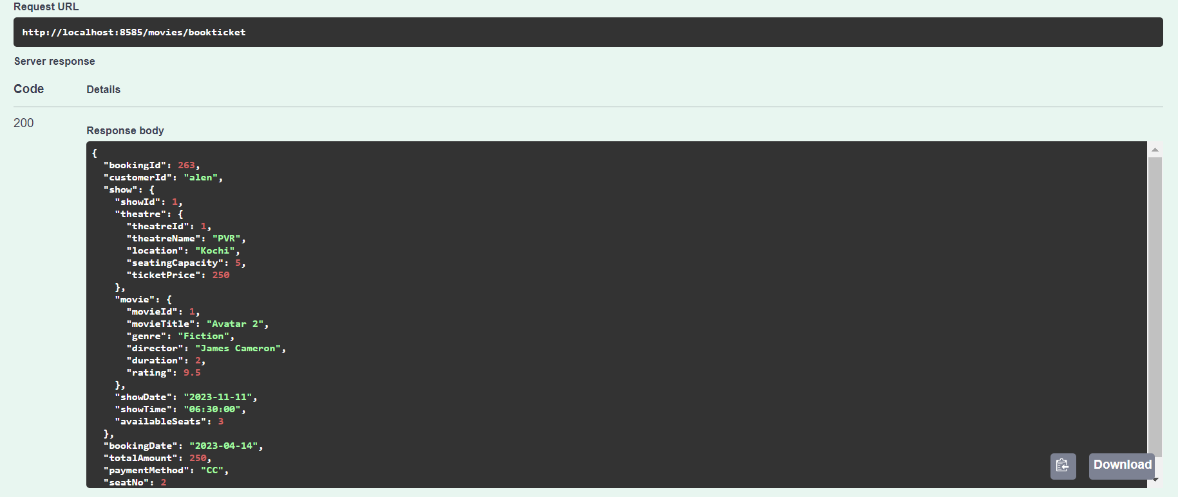
Screen Shots
Ticket Booking

Slide 18
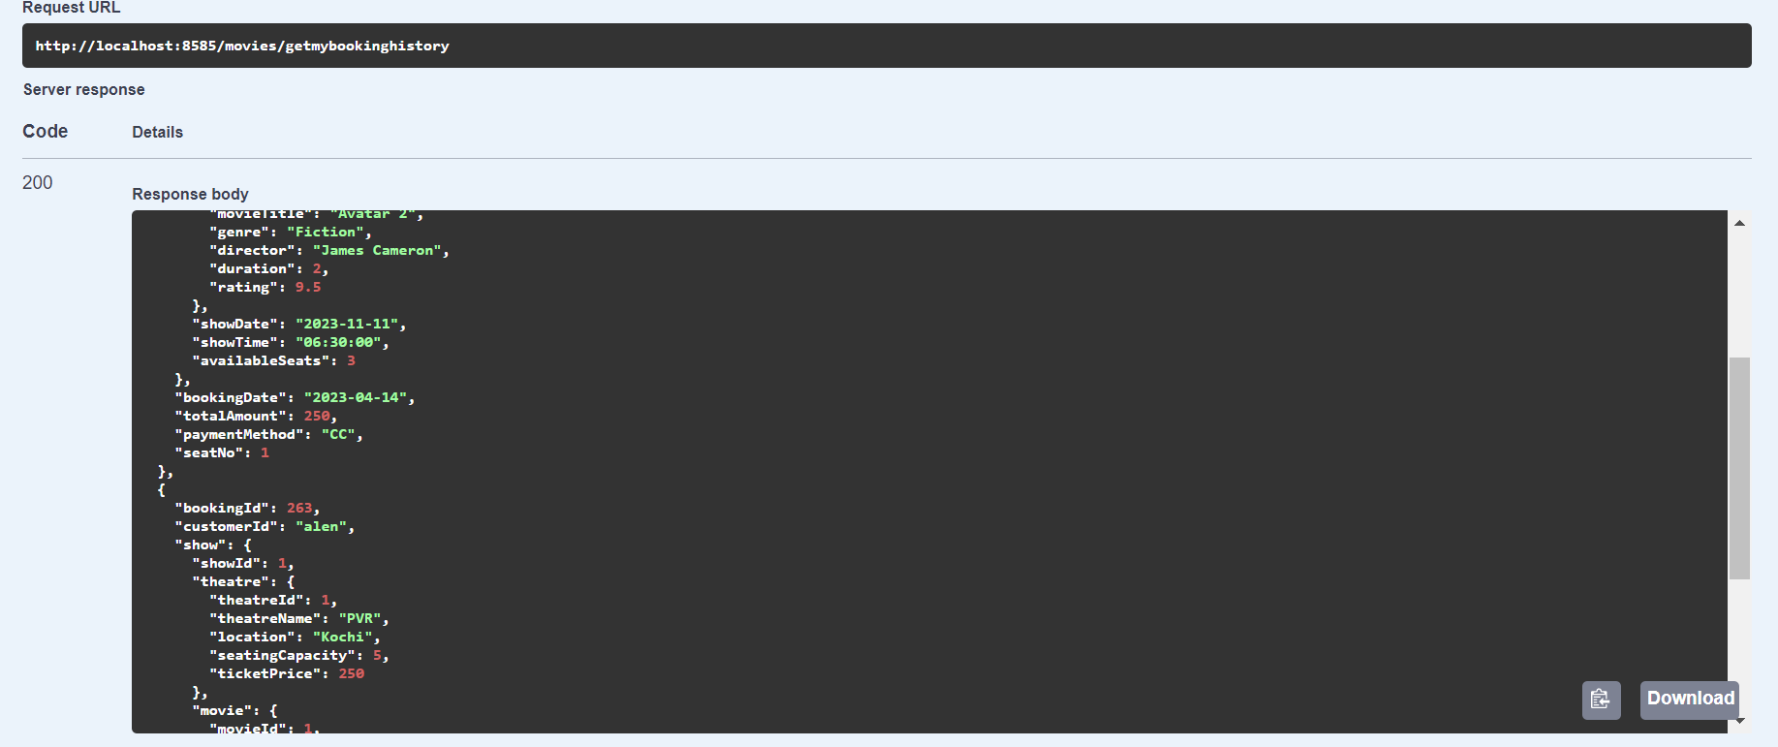
Screen Shots
Booking History

Slide 19
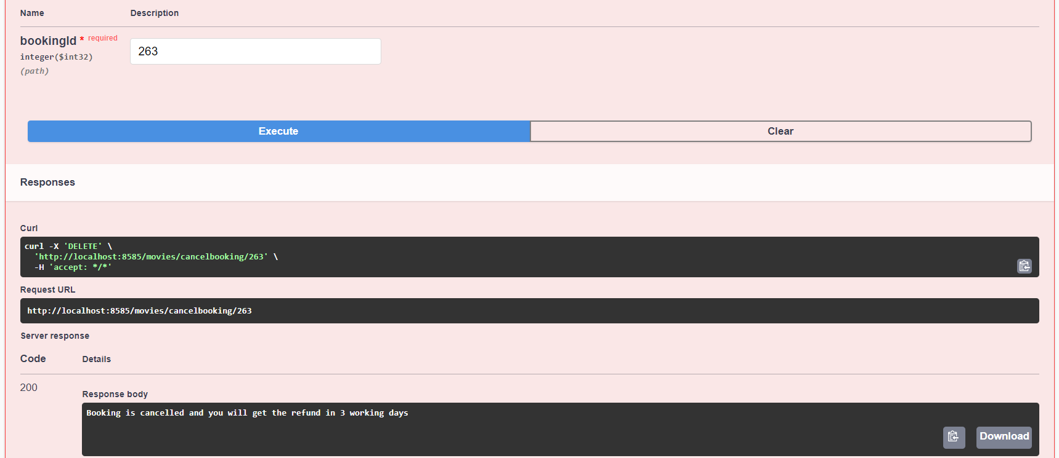
Screen Shots
Cancel Booking

Slide 20
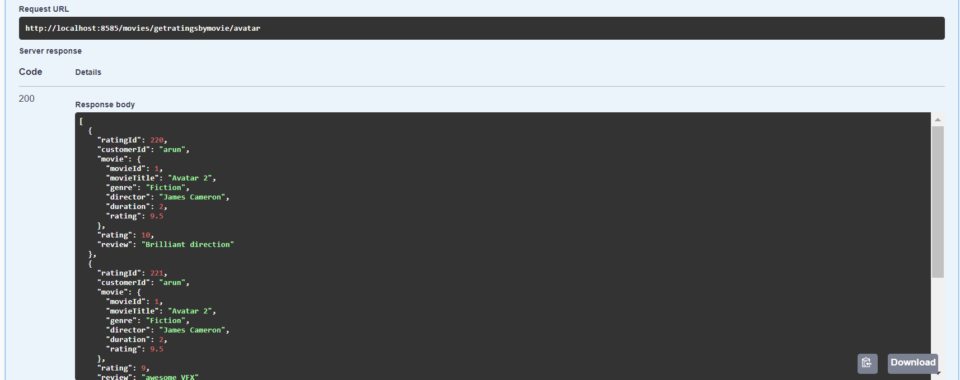
Screen Shots
View Ratings

Slide 21
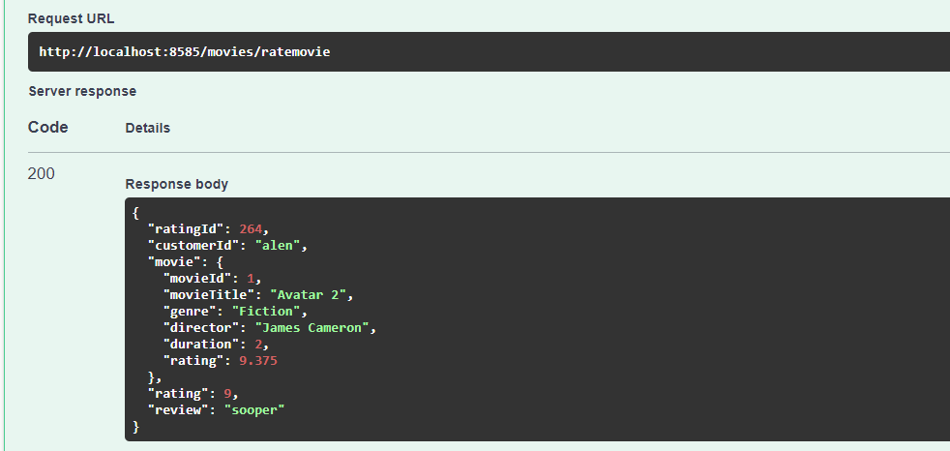
Screen Shots
Add Ratings

Slide 22
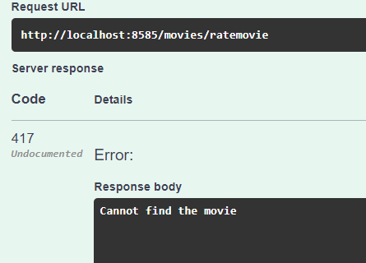
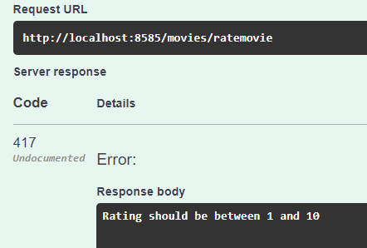
Screen Shots
When User Enters Invalid
Movie ID
When User Enters Invalid
Ratings

Slide 23
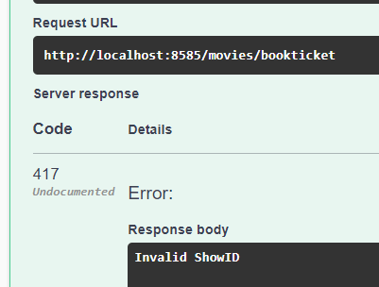
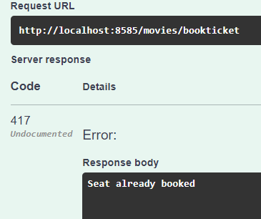
Screen Shots
When User Enters Invalid Show ID
When User Enters seat no which is already sold out

Slide 24
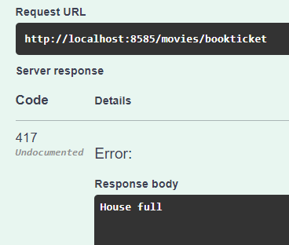
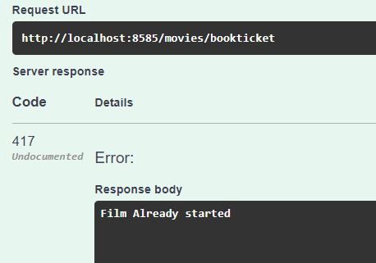
Screen Shots
When User tries to book ticket, When all seats are sold out
When User tries to book ticket after show begins

Slide 25
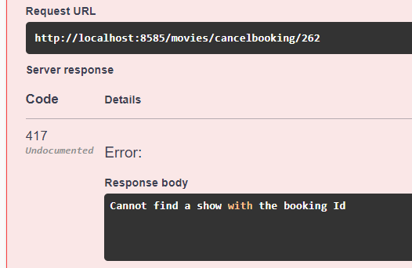
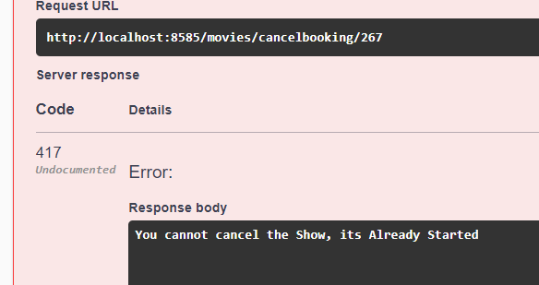
Screen Shots
When User Enters Invalid Booking ID
When User tries to cancel ticket after movie begins starts

Slide 26
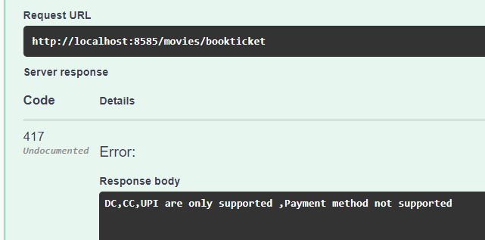
Screen Shots
When User Enters not supported payment option

Slide 27
Conclusion
movie booking app offers an easy and convenient way for users to browse and book their favourite movies at their preferred theatres. Our app provides a seamless user experience with a simple and intuitive interface.

